Slide 1
ADVANCED ANALYTICS
Hari Krishna Kantipudi

Slide 2
Agenda
01
Introduction to Reporting Capabilities
02
Road Map
03
Problem Statement
04
Data Source and Exploratory analysis
05
Regression Model
06
Confusion Matrix and Prediction Accuracy
07
Conclusion
08
Q & A

Slide 3
INTRODUCTION TO
Reporting CAPABILITIES

Slide 4





Business Insights
Data Quality
Operational Efficiency
Data Science Capabilities
Deliver Business Insights on
Patient Journey
SP Performance
Brand Performance
Prescriber trends
Payer Performance
Sales Force Execution
Adherence to Data Quality
DQM Specialty Dashboard
Reconciliation Reports
Heat Map
Bring in Operational efficiency by Monitoring
Patient Conversion Rate to Commercial Dispenses
Time to Fill
Cancellations and Discontinuity
Persistency and Therapy adherence
Explore Data Science Capabilities by using Machine Learning Algorithms and predicting drivers for Business and Sales acceleration like
Build a Linear Predictive Business model to determine if a patient will discontinue
Build a Logistic Predictive model to provide insights to
increase Conversion %
Value : Improve Patient Acquisition and retention
Value : Internal Operational Efficiency
Value : Answers Customized questions and complex business queries
Value : New Revenue

Slide 5
Road Map
Built an inventory of metrics
Established Data Quality Analytics Practice
POC using Machine Learning Algorithms
Created Data Dictionary
Designed Analytics Capability Model

Slide 6
PROBLEM STATEMENT

Slide 7


PoC – Using Machine Learning
Building a Model to Predict Discontinuity of Patients
Define use Case
To predict the chances of Discontinuity of a Patient from Therapy/Drug
Prepare the Data
Data Cleansing and Integrating
Train the Model
Set aside a quarter of labelled data for testing and 3/4th data to train the model
Make Predictions on New data
Based on the patterns recorded we indicate the chances of patient getting discontinued
Deliver data for decision support
The regressions and clustering concepts used are run every time the data is refreshed and sent to Clients to help in decision support
Enabling your Business Outcome

Slide 8

Data Source
Client
Considering Sanofi Praluent data
Data Criteria
Train Logistic regression model by data past 4 years
Provide insights on features or parameters that lead to a discontinued patient

Slide 9
EXPLORATORY DATA ANALYTICS

Slide 10
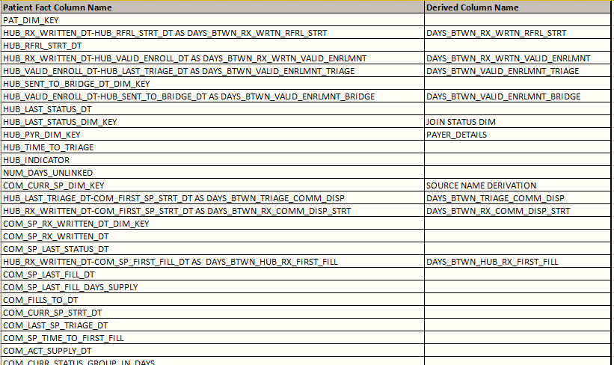
Data Exploration
Considering all Patient data since 2015 and their features related to Prescriber, Payer, Journey
Standardizing features related to Patient and to build a machine learning model, we should be identifying attributes that lead a customer to discontinue from Therapy or a drug
Days on PAP/Bridge/FTRIAL
Duration to traverse to next milestone
Number of Fills
Days on Journey
Heading
Unlinked Triages
Payers where there are more discontinued
Provider/Payer
Region where there are more Discontinued
SP/Region

Slide 11
IN PROGRESS
Training the MODEL

